Slide 1
HERE ARE SOME INSIGHTS ON SALES PREDICTION DATA

Slide 2
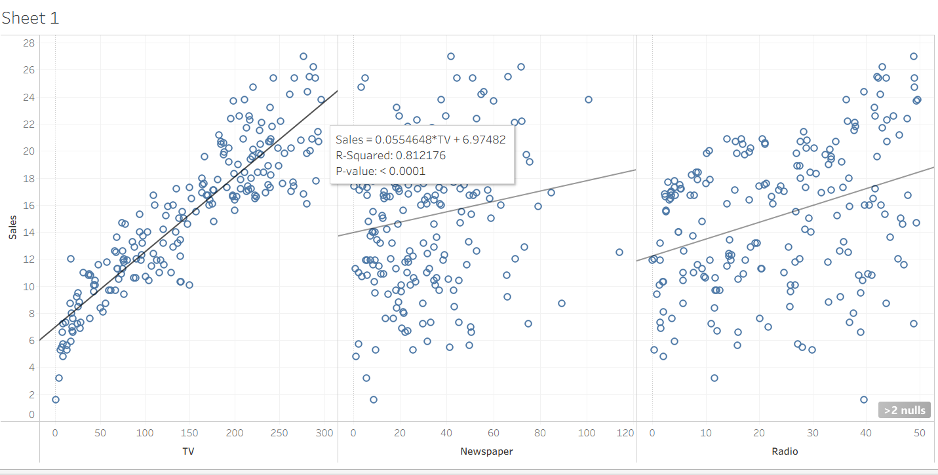
The scatter plot between TV and Sales shows a strong positive relationship, indicating that increased TV advertising leads to higher sales.

Slide 3
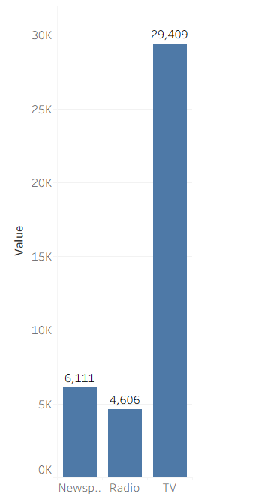
This indicates that the company invests more in TV as a marketing channel. Radio and Newspaper have relatively lower spending, suggesting they are less prioritized. This supports the analysis that TV plays a major role in influencing sales.

Slide 4
HERE ARE SOME INSIGHTS ON FACEBOOK LIVE SELLERS DATASET

Slide 5
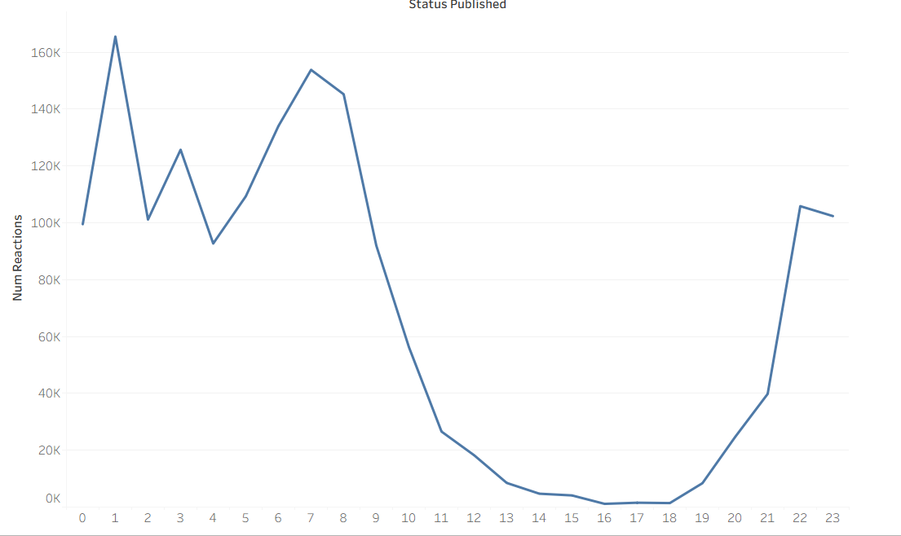
Showing which time of day gets more reactions

Slide 6
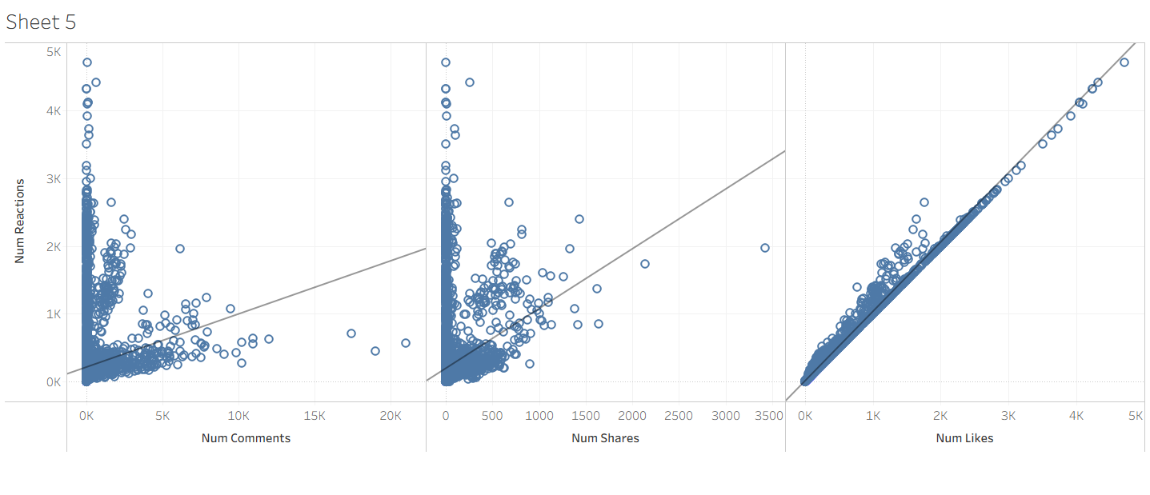
This suggests that likes contribute significantly to overall reactions, while comments and shares have a lesser but still positive impact.

Slide 7
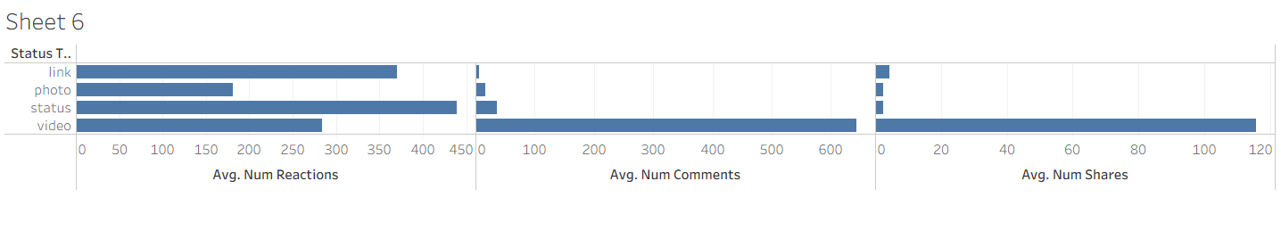
Videos → best for engagement (comments + shares)
Links → best for reactions
Photos & Status → lower engagement

Slide 8
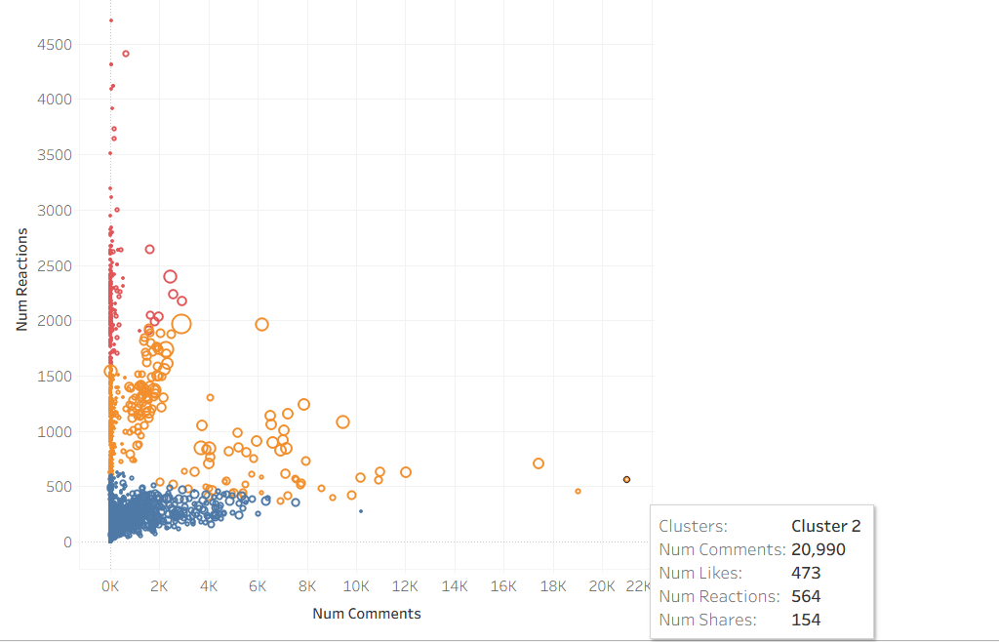
Posts are divided into high, medium, and low engagement groups through Cluster 1 , Cluster 2 , Cluster 3

Slide 9
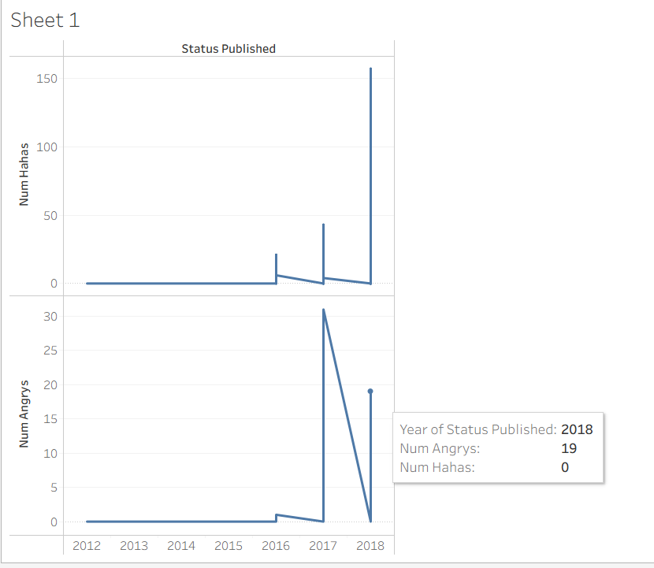
Year Wise status published found posts funny or angry

